Slide 1

JOB RECOMMENDER

Slide 2
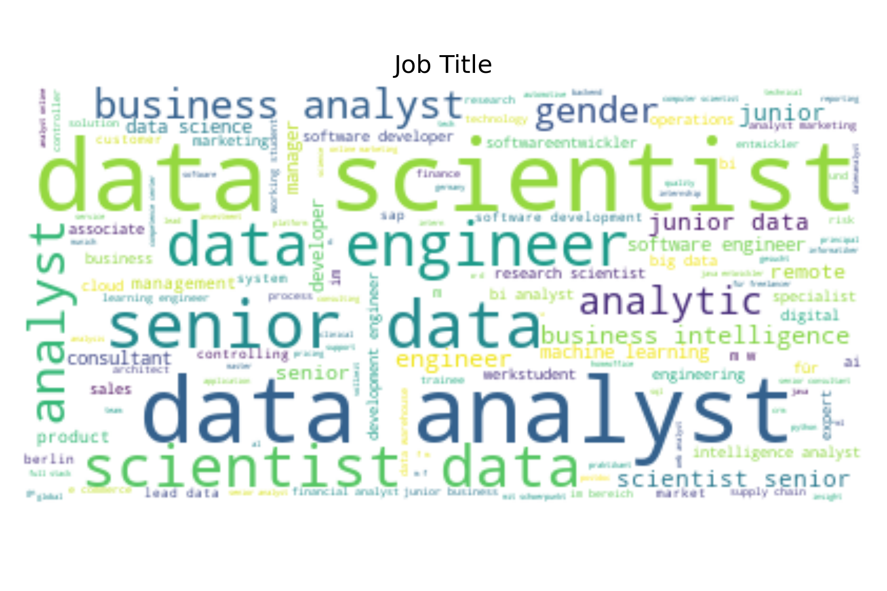



Data Aquisition
Keyword : Data scientist, Data Analyst
Place : Germany

Slide 3
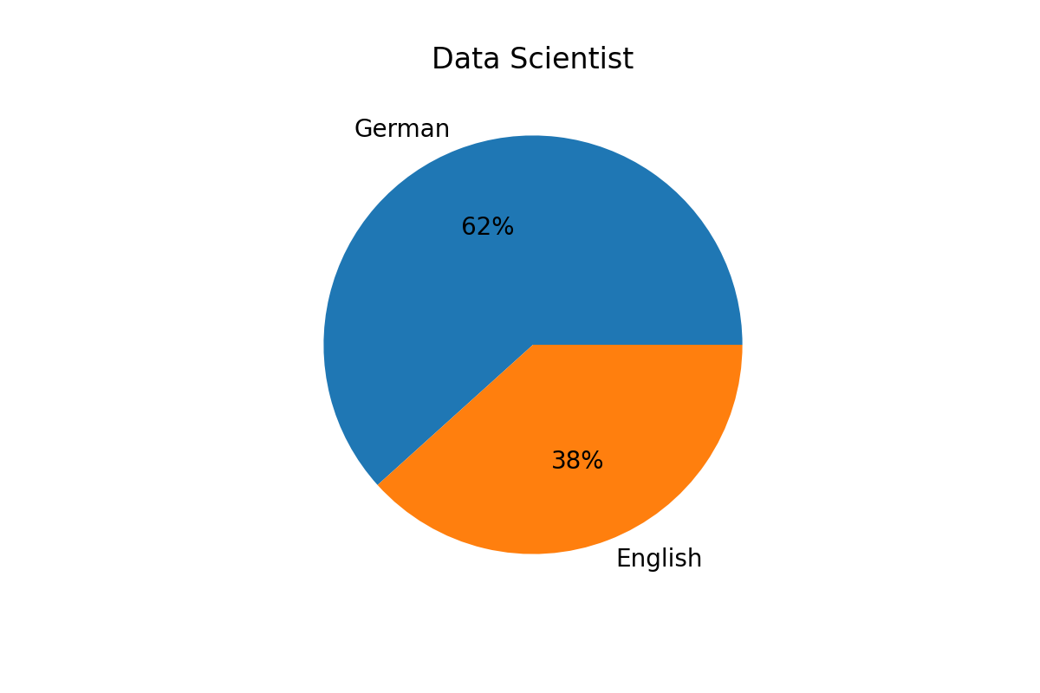
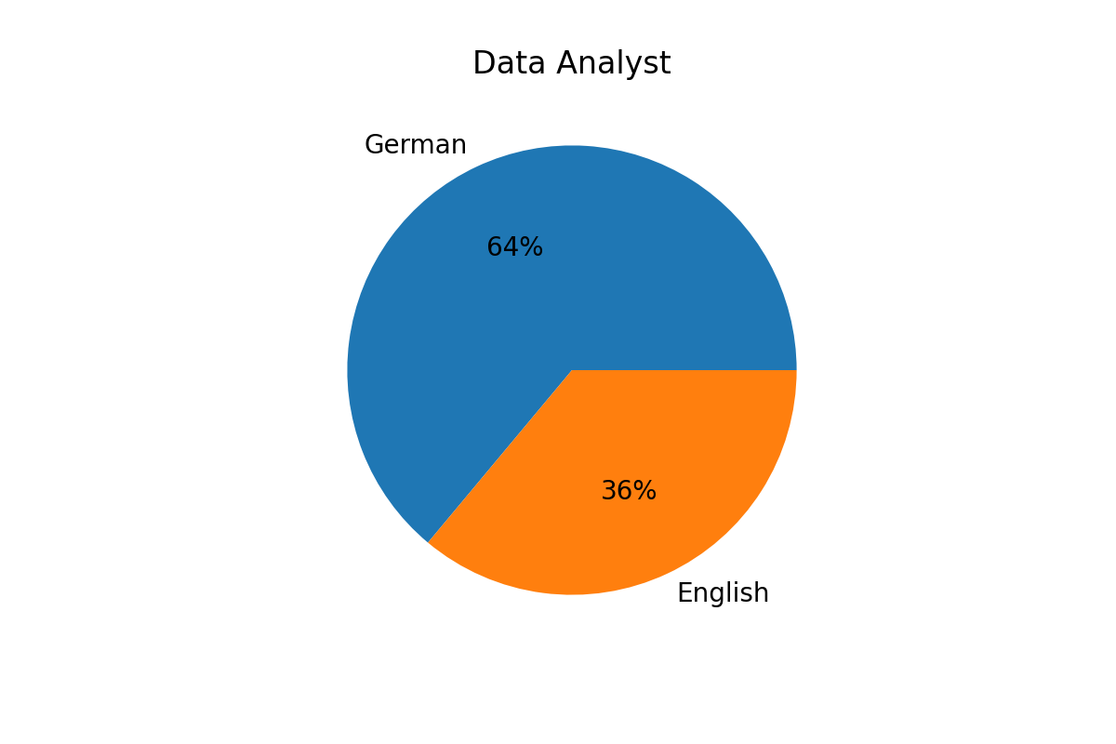
Language

Slide 4
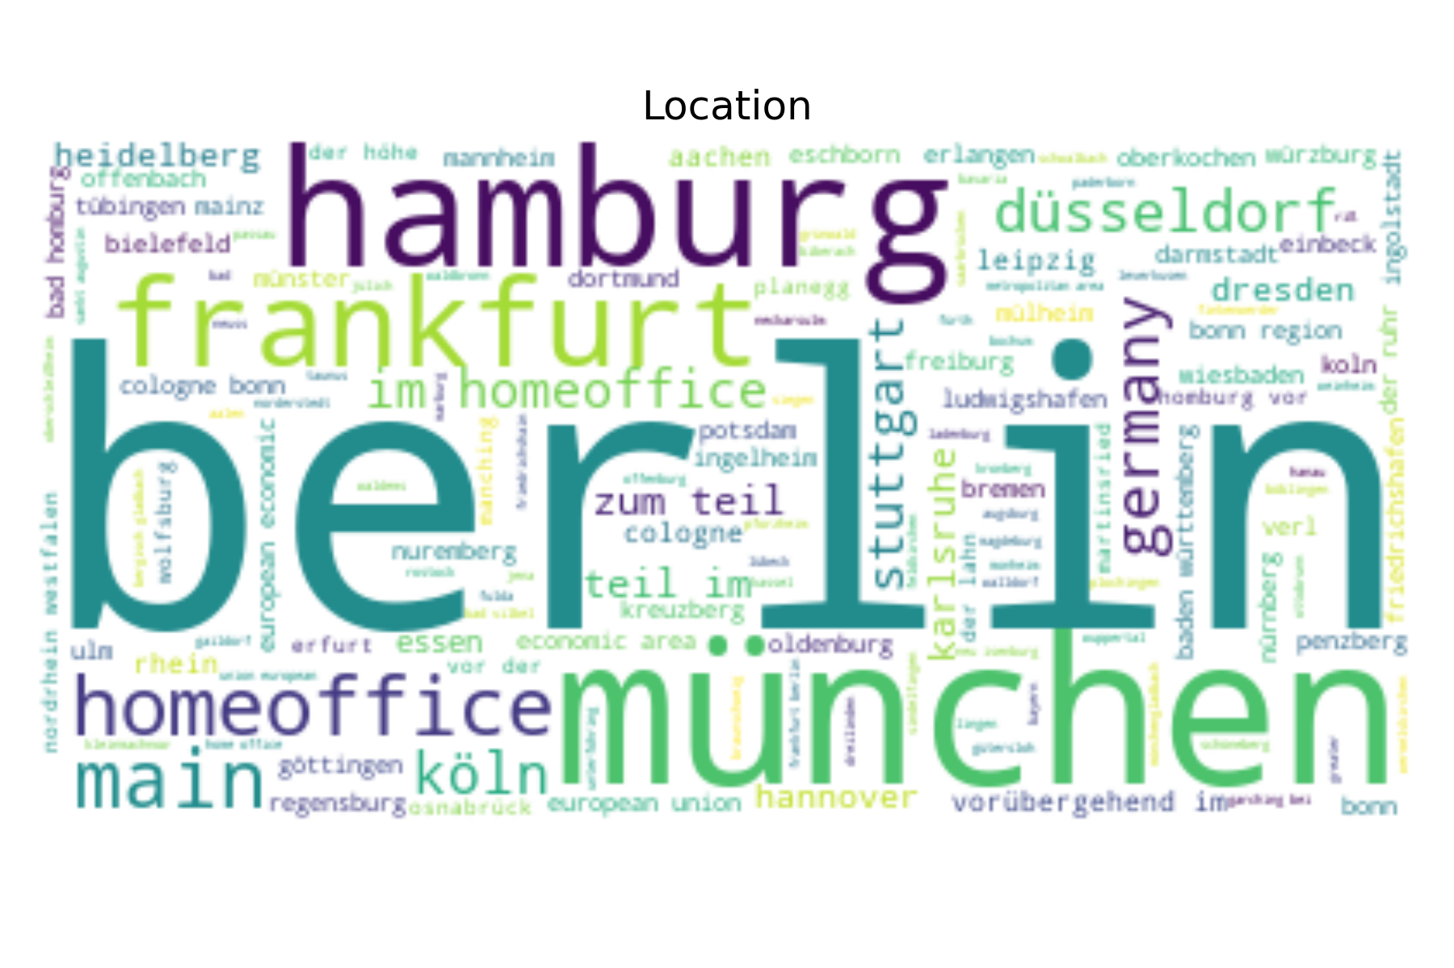
Location
1. Berlin
2. Munich
3. Hamburg
4. Homeoffice
5. Frankfurt, Stuttgart, Düsseldorf

Slide 5






Company

Slide 6
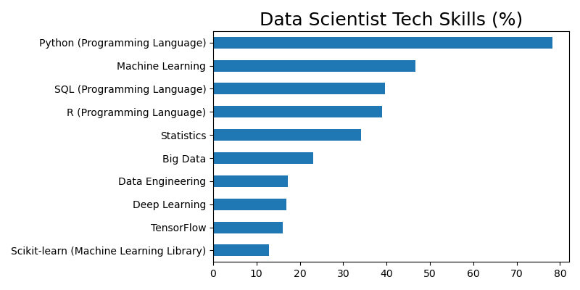
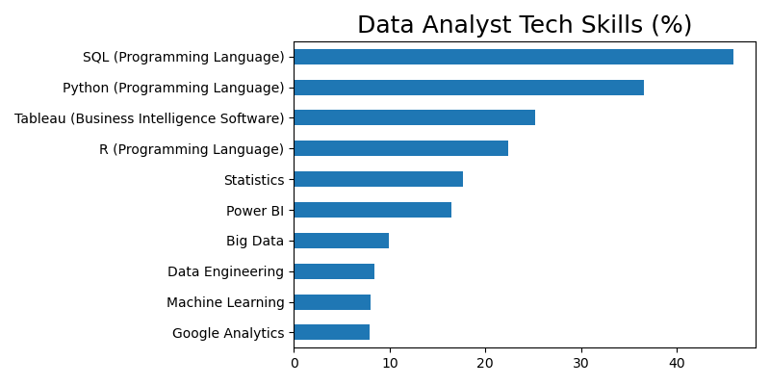
Tech skill

